Slide 1

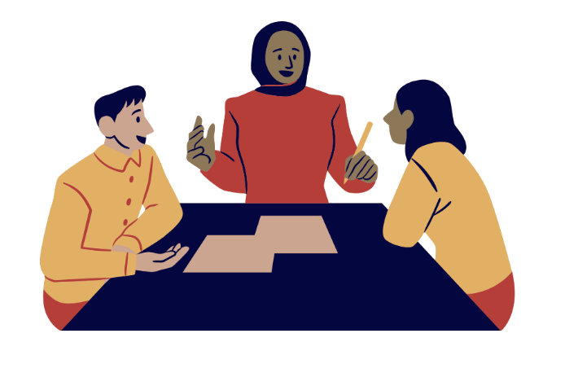


‘Moving on to the next case’
A workshop to reflect on young people’s reactions to safeguarding panels for extra-familial risks and harms
This resource was made in collaboration with the Young Researchers’ Advisory Panel (YRAP) from the Safer Young Lives Research Centre at the University of Bedfordshire.

Slide 2
Some notes for the facilitator before you begin

Slide 3



Instructions
This workshop is to help multi-agency partners who participate in safeguarding panels for extra-familial risks and harms (EFRH) to critically reflect on what young people think about these types of panels.
It is designed to be a group activity. It can be conducted with multi-agency partners who regularly attend panels together, or by single agencies reflecting on their role within these panels. It could also be an effective resource to support the training of panel chairs.
It should last about 60 minutes. There is an optional bonus section (see slide 6).
We recommend that you nominate 1 facilitator.
Each slide has a logo at the bottom that explains to the facilitator what to do with estimated timings.
Key to logos
Read this slide out to the group
This is an activity
Discussion
1 minute

Slide 4
This workshop includes
An introduction that explains the purpose of this workshop and how it was created in collaboration with young people.
A group activity that involves watching the fictional safeguarding panel video and reflecting individually and as a group.
A second group activity that involves watching a second video, which shows young people’s reactions to this fictional panel, followed by a group discussion.
Space to develop action point for yourself, your panel colleagues/team, and your organisation.

Slide 5
Overview
Introduction
5 minutes
Video activity 1: fictional panel video
20 minutes
Video activity 2: young people’s reactions
25 minutes
Next steps
10 minutes

Slide 6
Optional add-on activity
If you have time, you can add a third activity after the second video activity and before the next steps section.
This third activity shows an example of how the same fictional panel could have been improved (see slides 20-21).
It adds an extra 20-25 minutes to the workshop.

Slide 7
Start of workshop

Slide 8
Introduction

Slide 9
About this workshop
This workshop was developed as part of The Innovate Project, which explores how services are innovating to address extra-familial risks and harm (EFRH) experienced by young people outside of the family home.
This workshop is designed for panel chairs and any professional who participate in safeguarding panels. It was developed based on extensive observations of a range of panels for young people experiencing EFRH, and in collaboration with young people with lived experiences of these panels, who are members of the Young Researchers' Advisory Panel (YRAP) at the Safer Young Lives Research Centre, University of Bedfordshire.
This workshop was designed because young people’s voices are often absent from these panels and we wanted to hear what young people thought about them.
The purpose of the workshop is for professionals to hear from young people and critically reflect on their own panels and consider how they can be more inclusive of young people’s voices.
1 minute

Slide 10
How the fictional panel video was created
The first video you will be shown is a fictional safeguarding panel for addressing extra-familial risks and harms.
The fictional panel is based on a script created by two researchers from the Innovate Project, who are also part of the Contextual Safeguarding Research Programme at Durham University. These researchers, and colleagues from the Contextual Safeguarding team, have conducted many observations of these types of meetings (over 200 meetings have been observed collectively by the team).
The language in the script for this fictional panel is directly inspired from these observations. Direct quotes from meeting observations have been used but some details were changed for anonymity.
For this exercise, the language overall was ‘toned down’ to avoid making the video too upsetting for young people to watch.
Colleagues from the Innovate Project acted the script.
1 minute

Slide 11
A note from the researchers who made the video
This point of this exercise is NOT to make fun of anyone.
We created this video because often young people are not invited into these spaces and we wanted to show them what we had observed in these meetings and ask them what they thought about it.
This workshop aims to start a conversation about what these young people have said and to encourage you to critically reflect on your own experiences of these panels in a supportive way – not to point the finger or make anyone feel bad!
You might feel uncomfortable, defensive, or feel some resistance during the workshop. That’s OK. We appreciate this is not an easy exercise, but we hope that these discussions will feel supportive and helpful.
1 minute

Slide 12
Activity 1

Slide 13
Activity 1 – fictional safeguarding panel video
The fictional panel video is broken down into 3 clips.
After the first two clips you will have a minute to reflect alone.
After the third clip you will have 10 minutes to reflect as a group (or in small groups depending on numbers).
1 minute

Slide 14
Video clip 1
Watch clip 1: https://vimeo.com/837829451?share=copy
    All the videos for this workshop are also on the Innovate Project website resource page.
Reflection on your own (1 minute):
- How do you feel after watching this?
- What could be done differently?
5 minutes

Slide 15
Video clip 2
Watch clip 2: https://vimeo.com/837842826?share=copy
Reflection on your own (1 minute):
- How do you feel after watching this?
- What could be done differently?
3 minutes

Slide 16
Video clip 3
Watch clip 3: https://vimeo.com/837842016?share=copy
After watching the video, go straight into feedback in groups (10 minutes).
Feedback on the questions you have been asked to reflect on:
- How did the three clips make you feel?
- What could be done differently?
12 minutes

Slide 17
Activity 2

Slide 18
Activity 2 – young people’s reactions
Now you will see young people’s reactions to the video. The fictional panel video was shown to 4 young people who are members of the Young Researchers' Advisory Panel (YRAP) at the Safer Young Lives Research Centre, University of Bedfordshire. It was shown to them in a series of online workshops that were audio-recorded.
To share their reactions, the researchers created a WhatsApp conversation between two fictional young people – Lily and Nathan. These young people are fictional, but everything they say in this conversation is lifted directly (ad verbatim) from the transcripts of the workshops.
You will watch the video and then share your reflections as a whole group.
Scripts are available on the resources webpage for those who struggle to read the conversation.
1 minute

Slide 19
Young people’s reactions video
Watch the video: https://vimeo.com/914412323/de82151687?share=copy
How did watching young people’s reactions make you feel?
Discuss for 10-15 minutes.
22-25 minutes

Slide 20
OPTIONAL activity 3 – a different way
We created a video of the same panel, with the same people discussing the same case. We wanted to show how, in these same conditions, the chairing and discussions could have been different.
We made a version that is improved, based on the feedback from the YRAP.
It's important to keep in mind that we have only changed what we could control in the meeting. We are not saying that this is a perfect example, but it shows the choices that we do have even when working in imperfect systems.
This activity adds 20-25min to the workshop.
1 minute

Slide 21
OPTIONAL activity 3 – a different way (2)
Watch the video of the alternative panel:
https://vimeo.com/888686287/384269cb3d?share=copy
Discuss as a group (5-10 minutes)
How did watching this video made you feel compared with the previous version of this panel?
What did you notice was different about this version?
What did you find helpful about this version?
20-25 minutes

Slide 22
Next steps…
Reflect on the following as a group
You
What is the main thing that you take away from this workshop?
Write a promise to yourself about one thing that you will do differently when attending panels going forward.
Your panel/team
How can your panel/team make panels from inclusive of young people’s voices in light of what was discussed today?
Think of some ideas now and plan a time soon to discuss this together and come up with a plan. Remember to build in critical reflection into your plan.
Your organisation
What can your organisation do? This could be reviewing how language is used to discuss young people, creating more opportunities for staff to reflect and be supported...Who can you feed this back to and how?
10 minutes

Slide 23
We hope this workshop was useful.
For feedback please contact m.lefevre@sussex.ac.uk
For more resources please visit the Innovate Project website: https://theinnovateproject.co.uk/

