Slide 1
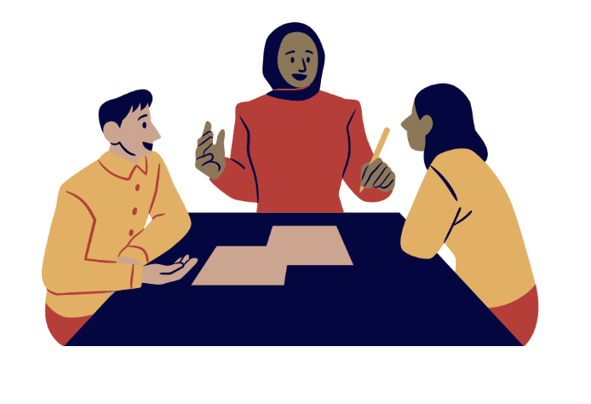
‘Moving on to the next case’
A workshop to reflect together about safeguarding panels
This resource was made in collaboration with the Young Researchers’ Advisory Panel (YRAP) from the Safer Young Lives Research Centre at the University of Bedfordshire.

Slide 2
Some notes for the facilitator before you begin

Slide 3
Instructions
This workshop is to consult with young people about what they think of safeguarding panels for extra-familial risks and harm.
It is designed to be a group workshop.
It should last about 60 minutes.
Before starting to plan the workshop, the facilitator should read the accompanying facilitator guide.
This set of slides guides the facilitator through the workshop.
Each slide has a logo at the bottom left corner that explains to the facilitator what to do with estimated timings.
Key to logos
Read this slide out to the group
This is an activity
Discussion
1 minute

Slide 4
Overview
Introduction 10 minutes
Video activity 45 minutes
Close 5 minutes

Slide 5
Introduction

Slide 6
Welcome & Introductions
Introduce yourself and let others in the group introduce themselves (if you do not already know each other)
Optional warm up activity
5 minutes

Slide 7
What is this workshop about?
This workshop was designed by researchers. Their work looks at how professionals respond when young people get harmed in places where they spend time outside of their home – like school, when they are with friends, online spaces or any other places in their communities.
As part of their work, the researchers look at how professionals are working in new ways to support young people from harm in these spaces.
When young people experience harm outside the home, professionals like social workers or the police hold meetings to talk about the young people they are worried about and to create plans to make young people safer.
The researchers have observed many of these meetings. Most of the time young people are not present at these meetings so it’s hard for them to know what is going on and what professionals are saying about them.
The researchers created this workshop, with the help of young people who have experienced these types of panels, to show other young people what these panels are like and hear what they think about them. The young people who helped to create this workshop are part of the Young Researchers' Advisory Panel (YRAP) at the Safer Young Lives Research Centre, University of Bedfordshire.
3 minutes

Slide 8
Group agreement
Remind participants that they won’t be asked to talk about their own experiences
Explain that everything that is shared in the workshop is confidential and under what circumstances information would need to be shared
Remind participants why you are having this workshop and how you plan on using what they tell you
Remind them how they can get support if they need to
Remind them that can can withdraw afterwards by speaking to you
You can remind them of any other relevant group agreements
2 minutes

Slide 9
Video activity

Slide 10
Introducing the activity
The researchers wanted to create a video to show young people what safeguarding panels were like and hear what young people thought about them. They wrote a script, based on the many meetings that they observed, and acted it out.
You will watch the video of the fake panel and then share your thoughts about it.
The video is about a fictional young person named Kyle. It’s broken down into 3 short clips. After each clip you’ll be asked to think about two questions and discuss them as a group:
How do you feel after watching this?
What could professionals in the meeting have done differently?
When we hear young people being talked about in meetings it can sometimes be upsetting or make us uncomfortable. [Name of support person] is here during the session if you want to have a chat during the session and afterwards.
2 minutes

Slide 11
Video clip 1
Play clip 1: https://vimeo.com/837829451?share=copy
All the videos in this workshop are also available on the Innovate Project website resources page.
Facilitate group discussion (10 minutes). Ask the group: - How do you feel after watching this?
- What could professionals in the meeting have done differently?
You can offer to play clips again if needed. If more appropriate, you can ask young people to reflect on these questions first on their own for a short while before going into a group discussion.
15 minutes

Slide 12
Video clip 2
Play clip 2: https://vimeo.com/837842826?share=copy
Facilitate group discussion. Ask the group: - How do you feel after watching this?
- What could professionals in the meeting have done differently?
14 minutes

Slide 13
Video clip 3
Play clip 2: https://vimeo.com/837842016?share=copy
Facilitate group discussion. Ask the group: - How do you feel after watching these videos?
- What could professionals in the meeting have done differently?
14 minutes

Slide 14
Close

Slide 15
Close
Thank participants for their contribution and give them compensation for their time
Tell them what next steps are and how the information will be used
Remind them they can withdraw if they want to
Optional closing activity
5 minutes

Slide 16
We hope this workshop was useful. For feedback please contact m.lefevre@sussex.ac.uk For more resources please visit the Innovate Project website: https://theinnovateproject.co.uk/

